Slide 1
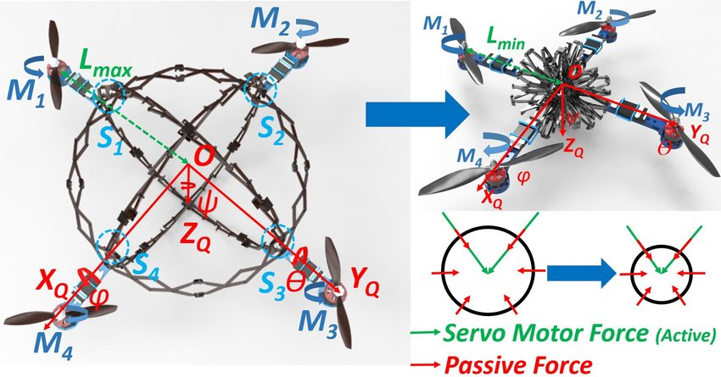
ME 161 Basic Mechanics
Mechanical Engineering Department, CoE, KNUST
Kwame Nkrumah University of Science and Technology, Kumasi, Ghana
Department of Mechanical Engineering
Course Lecturer:
Dr. C. Sekyere

Slide 2
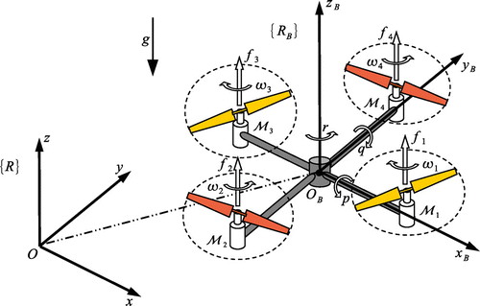
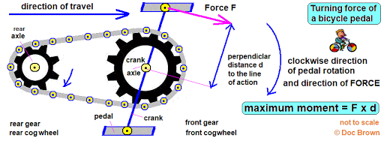
FORCES AND MOMENTS
Unit 2

Slide 3
Force Systems
A force is any effect that may change the state of rest or motion of a body (Refer to Newton’s 1st Law).
Hence, a force is the result of an interaction between bodies
The interaction may either be an actual contact or remotely, as in the case of gravitational and magnetic forces
A force system comprises 2 or more forces acting on a body or a group of related bodies.
Force systems are classified according to the arraignment of constituent forces.
A body is in equilibrium when all the resultant forces acting on the body is zero.
NB: No method exists for directly measuring a force. In mechanics, we use cause-and-effect relationship to measure force e.g. spring scale uses deflection of spring to measure weight (force) and beam scale uses balancing of moment to measure weight (force).

Slide 4
Types of Force System
  A force system may be one-, two- (planar) or three-dimensional (spatial)
  A force system is said to be collinear if the forces have a common line of action.
  Parallel if the lines of action of the forces are parallel
  Concurrent if the lines of action of the forces intersect at a common point
  Coplanar when all the forces lie in the same plane
  Spatial when all the forces do not lie in the same plane
F₃
F₂
F₁
F₂
F₃
F₄
F₁
Fig. 2.1
Non-Concurrent
Coplanar Force System
Concurrent Coplanar Force System
T₄
F
F₂
F₄
T₁
T₃
F₁
T₂
F₃
F
Parallel spatial Force System
Collinear Force System
Concurrent Spatial Force System

Slide 5
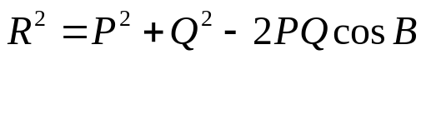
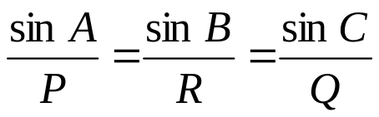

Addition of Vectors
P
For a pair of concurrent forces
Cosine Law (or Cosine rule)
R=Q+P
Q
Q
Sine Law (or sin rule)
P
Parallelogram law of vector addition
P
Vector addition is commutative
C
B
R=Q+P
Note : P, Q and R are magnitudes of vectors. A, B and C are interior angles of the vector triangle.
Q
A
Fig. 2.2
where A, B and C are angles

Slide 6
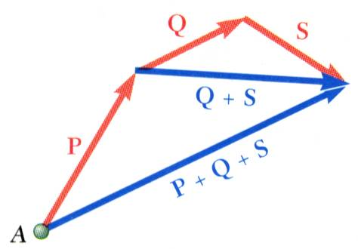
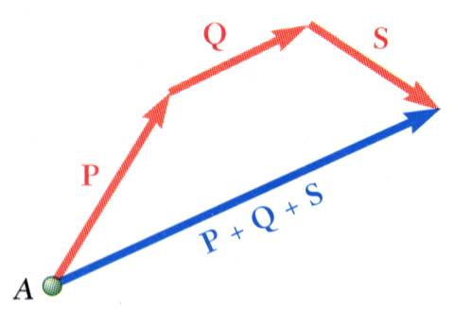
Addition of Vectors
Addition of three or more vectors through repeated application of the triangle rule
Fig. 2.3(a)
The polygon rule for the addition of three or more vectors.
Vector addition is associative,
Fig. 2.3(b)

Slide 7
Brief Review of Geometry
C
From Diagram (a),
D + A = 180º
D + C = 180º
A = C and B = D
From Diagram (b),
G = E=K=I
H =F=L=J
From Diagram (c),
M + N + Q =180
N =180 - P
D
B
(a)
A
H
G
E
F
(b)
L
K
I
J
Q
(c)
N
P
M

Slide 8
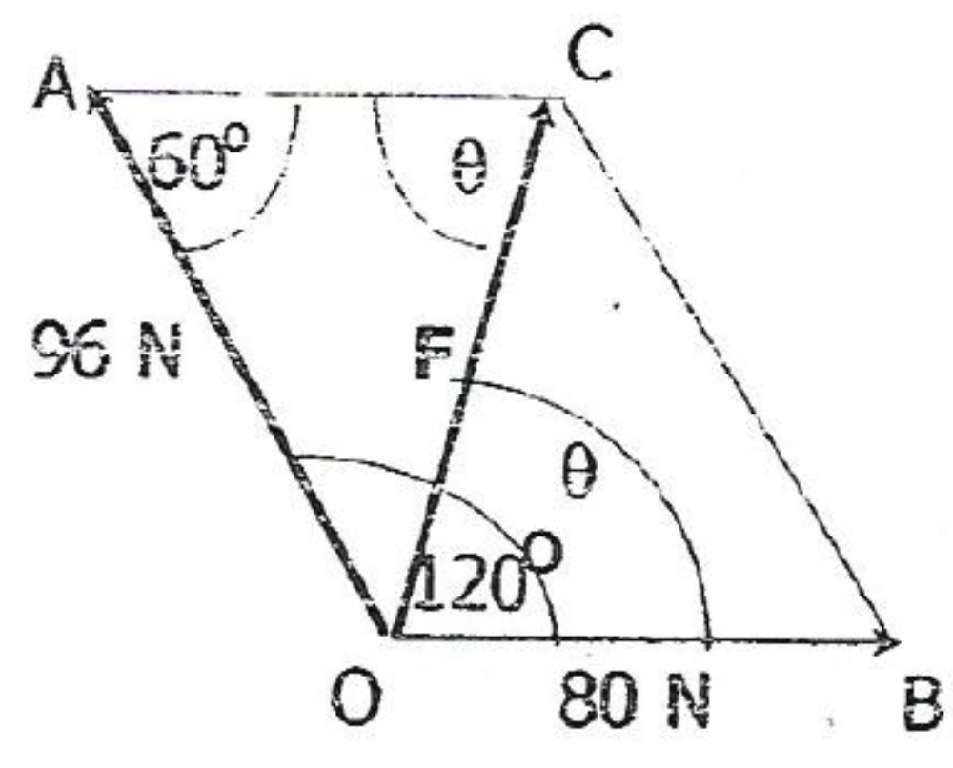
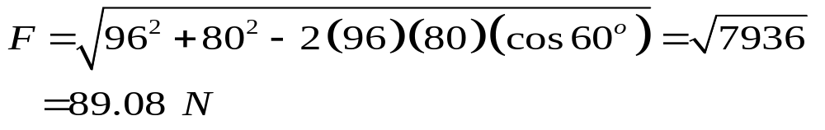
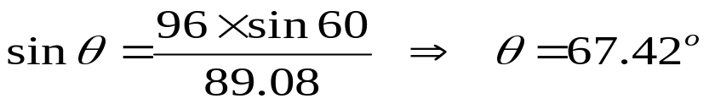
Example 2.1
Two coplanar forces with magnitude 96 N and 80 N act at a point O. Determine the magnitude and direction of the resultant if the angle between the forces is 120º
SOLUTION
From the parallelogram of forces shown, it is obvious that OC represents the magnitude of the resultant force F.
Applying the cosine rule
The angle θ which the resultant F makes with the 80 N
force is also found by the sine rule
Fig. 2.4

Slide 9
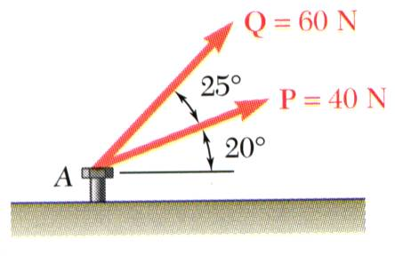
Example 2.2
Graphical Solution
Graphical solution - A half or full parallelogram with sides equal to P and Q is drawn to scale.
P’
Q’
Q
R
Fig. 2.5(a)
β
The two forces act on a bolt at A Determine resultant of forces Q and P acting on the bolt shown and the angle the resultant makes with the horizontal axis.
P
Fig. 2.5(b)
The magnitude and direction of the resultant or of the diagonal to the parallelogram are measured,
R = 98 N β = 35º

Slide 10
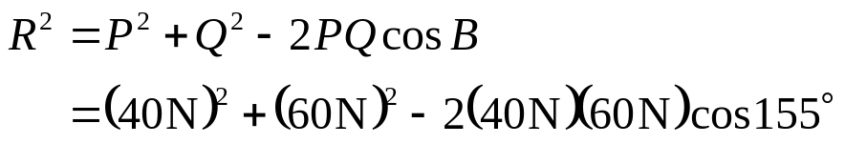
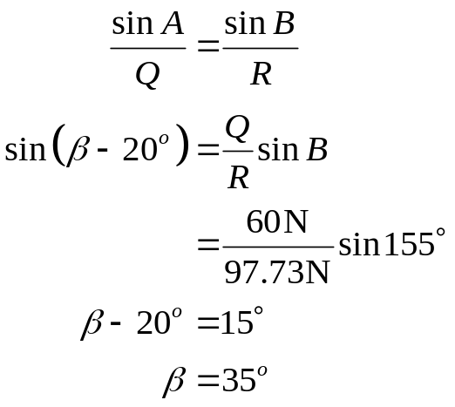
Example 2.2, Cont
Parallelogram solution
From the Law of Cosines,
C
155º
Q=60 N
R = 97.73 N
β-20º
25º
From the Law of Sines,
β
R
B
20º
P =40 N
A

Slide 11
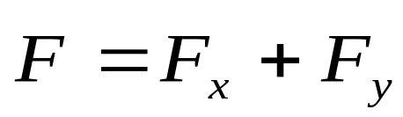
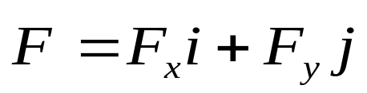
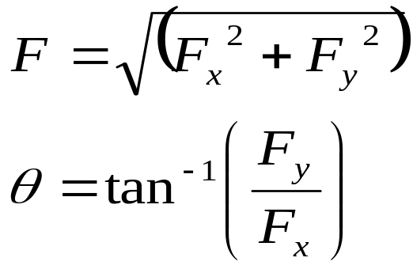
Rectangular Components of Force
y
A force vector may be resolved into perpendicular components so that the resulting parallelogram is a rectangle. The resulting x and y components are referred to as rectangular vector components and
F_{y}
F
θ
x
F_{x}
Vector components may be expressed as products of the unit vectors with the scalar magnitudes of the vector components.
Fig. 2.6
F_{x} and F_{y} are referred to as the scalar components

Slide 12
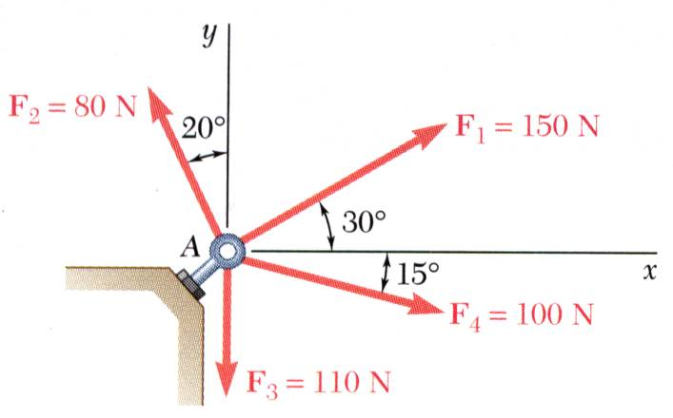
Example 2.5
SOLUTION:
Resolve each force into rectangular components.
Determine the components of the resultant by adding the corresponding force components.
Calculate the magnitude and direction of the resultant
Fig. 2.11
Four forces act on bolt A as shown. Determine the resultant of the force on the bolt.

Slide 13
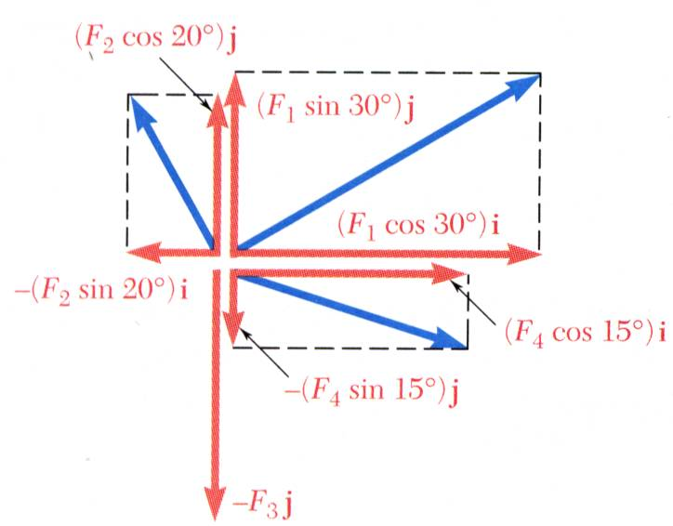
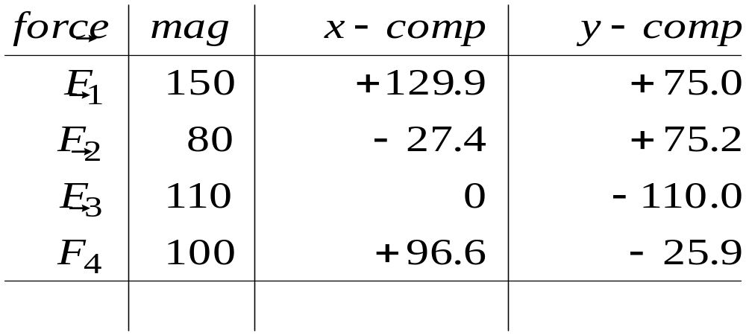


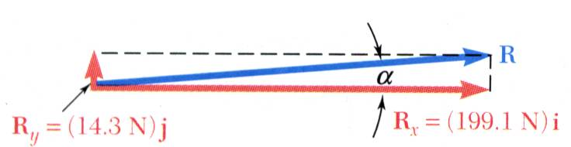


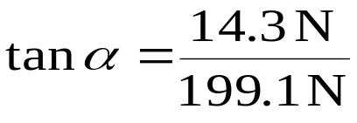

Example 2.5, Cont
SOLUTION:
Resolve each force into rectangular components
Determine the components of the resultant by adding the corresponding force components.
Calculate the magnitude and direction.

Slide 14
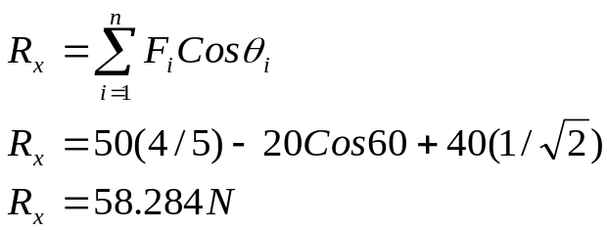
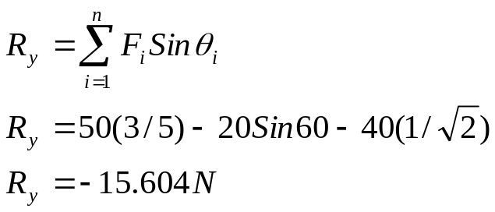
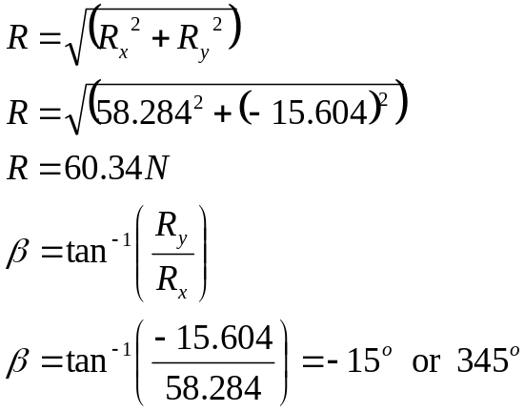
Example 2.6
Determine the magnitude of the resultant force and its direction measured from the positive x axis.
Solution
y
50 kN
5
3
4
x
60º
√2
1
20 kN
1
40 kN

Slide 15
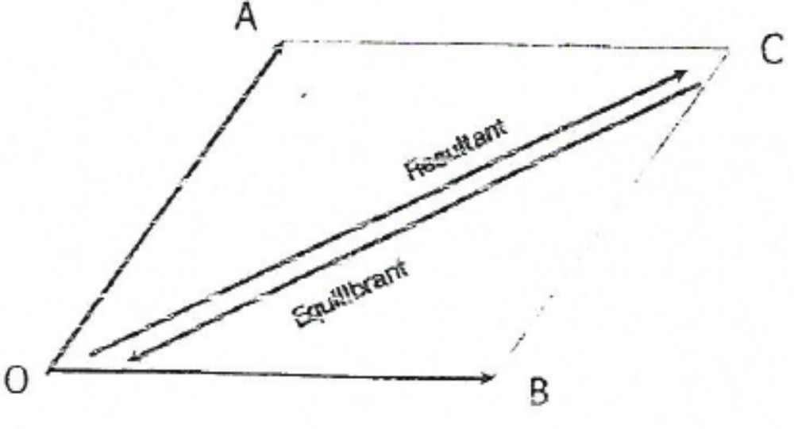
Equilibrium of a particle
Forces acting on a particle are necessarily concurrent since a particle is assumed to have infinitesimal size
When the resultant of all the forces acting on a particle is zero the particle is said to be in equilibrium
As a result, the sum of the components of forces in any direction must be zero, i.e
The forces required to bring a body to a state of equilibrium is called the equilibrant.
The equilibrant is equal in magnitude but opposite in direction to the resultant of the original force acting on the body
Let OA and OB represent the forces acting on the particle O.
Per the parallelogram law, the vector OC represents the resultant
It follows that if 3 forces, acting at a point can be represented in magnitude and direction by the sides of a triangle taken in order (e.g. OA, AC and CO), the forces will be in equilibrium
This result is known as the Triangle of Forces
Statement: If 3 forces acting on a particle are in equilibrium, they can be represented in magnitude and direction by the sides of a triangle taken in order
Can be extended to obtain the polygon of force
Fig. 2.9

Slide 16
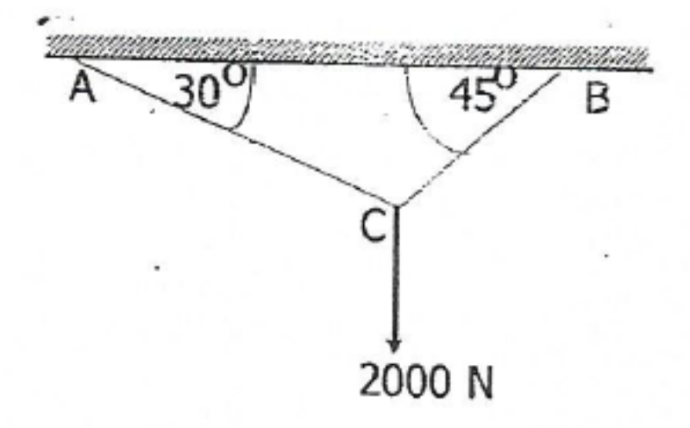

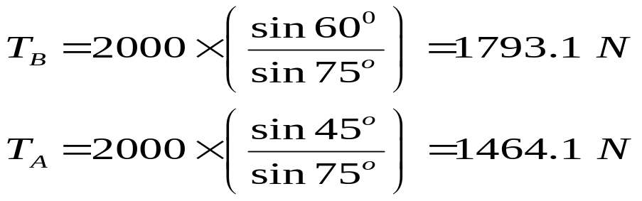
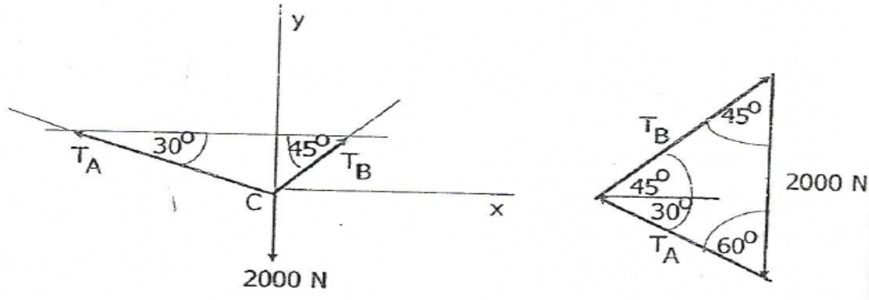
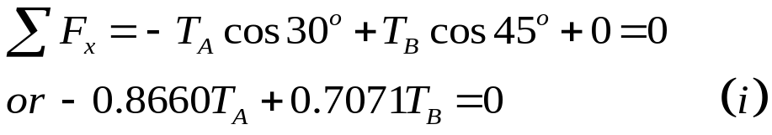
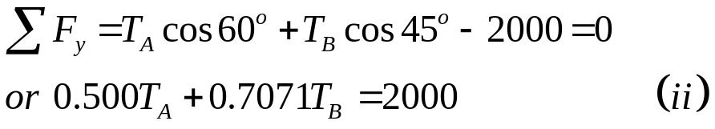
EXAMPLE 2.4
Two cables AC and BC are joined together at C and a load of 2000 N is applied as shown in the Fig.10 Determine the tension in the cables
Solving (i) and (ii) simultaneously gives
SOLUTION
Fig. 2.10
Alternatively, we can use the triangle of forces to find the components as follows
We isolate the particle at C and show, on a separate diagram, all the forces acting on it. Such a diagram is called a free-body diagram. Since the particle is in equilibrium, the sum of component forces in any direction should be equal to zero

Slide 17
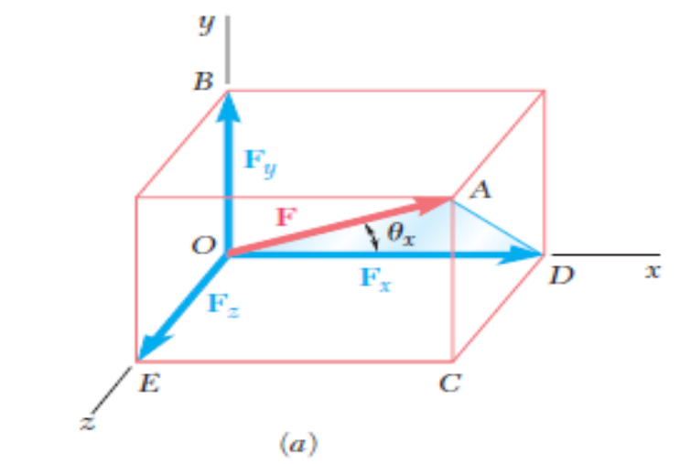
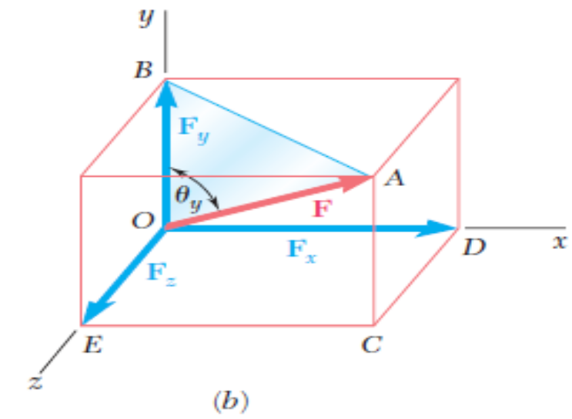
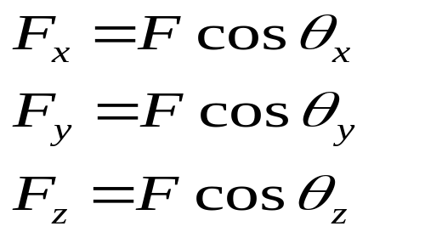
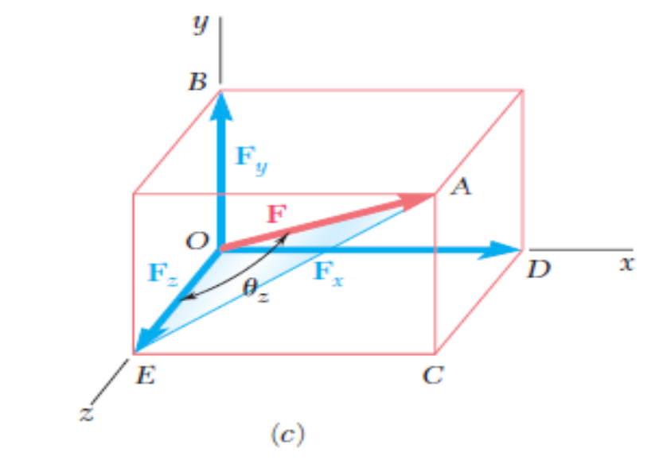
Rectangular Components of Force
Sometimes it is necessary, depending on the geometry of a problem, to resolve a force into 3 mutually perpendicular components parallel to 3 coordinate axes (see illustration in Fig.3)
Fig. 2.8

Slide 18
Cartesian Vectors
The three axes x, y and z are at right angles to each other.
i, j and k are the unit vectors along the x, y and z axes, respectively.
z
k
F_{z}
F
F_{y}
y
j
F_{x}
F_{xy}
i
x
Fig. 2.12

Slide 19


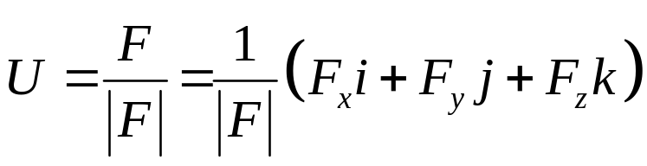
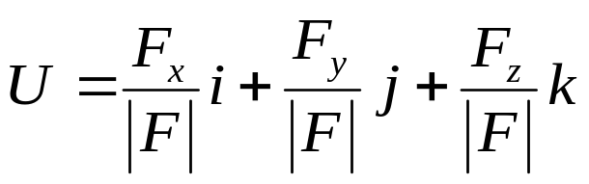
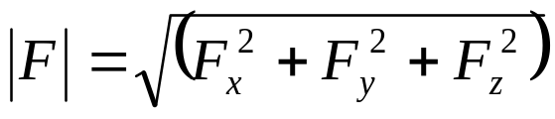
Vector Representation
Vectors are represented by the magnitudes and directions of the three components using the unit vectors i, j and k. e.g.
The magnitude of the vector is given as
A unit vector (also called normalized vector) U is a vector whose magnitude is 1.
If
Unit vectors are often chosen to form the basis of a vector space

Slide 20
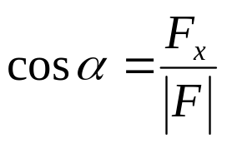
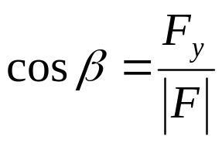
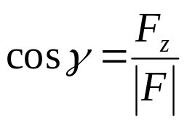






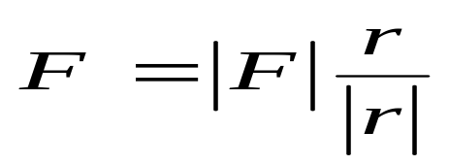
Direction Cosines
The direction cosines are the cosine of angles between the tail of a vector and the positive x, y and z axes.
Direction Cosines
z
k
F_{z}
F
F_{y}
y
If a force of magnitude is directed along a line r, then the force vector is defined as
j
F_{x}
i
x
Fig. 2.13

Slide 21
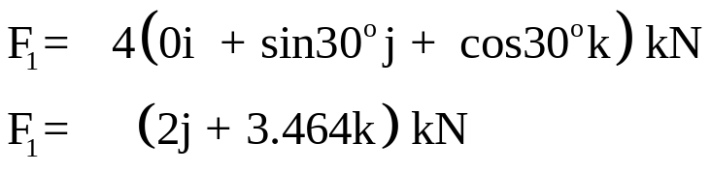
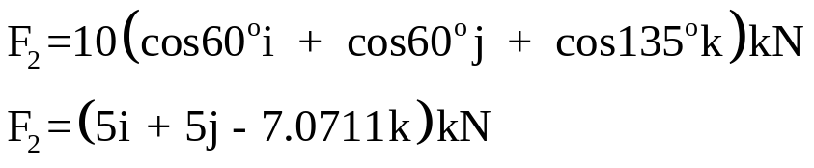
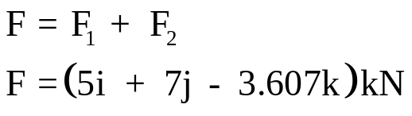
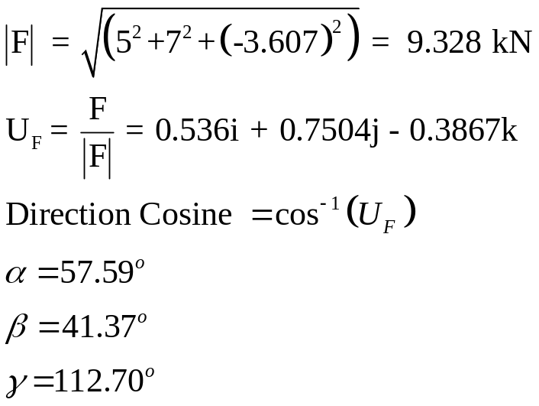
Example 2.7
SOLUTION
Determine the magnitude and coordinate direction angles of the resultant force
z
F₁ = 4 kN
30º
135º
y
60º
60º
x
F₂ = 10 kN

Slide 22
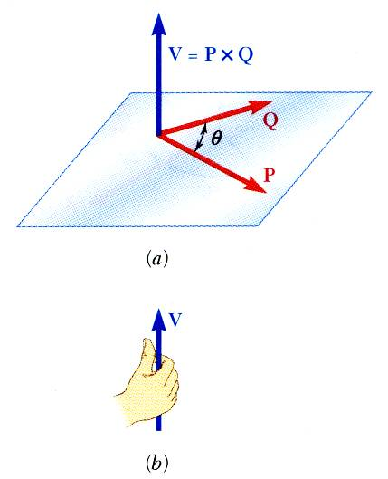

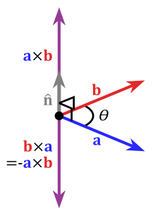


Product of Two Vectors
Vector product of two vectors P and Q is defined as the vector V which satisfies the following conditions:
  Line of action of V is perpendicular to plane containing P and Q.
  Magnitude of V is
  Direction of V is obtained from the right-hand rule.
Vector products:
  are not commutative,
  are distributive,
  are not associative,
Fig. 2.14

Slide 23
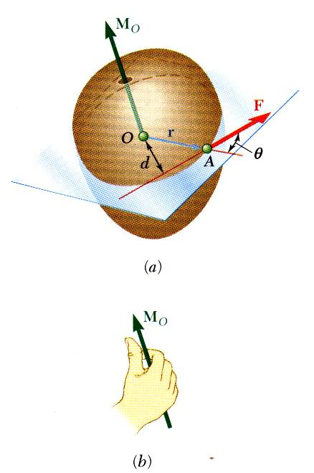


Moment of a Force
The moment of F about O is defined as
The moment vector M_{O} is perpendicular to the plane containing O and the force F.
Magnitude of M_{O} measures the tendency of the force to cause rotation of the body about an axis along M_{O}.
The sense of the moment may be determined by the right-hand rule.
Fig. 2.17

Slide 24
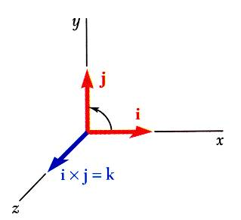
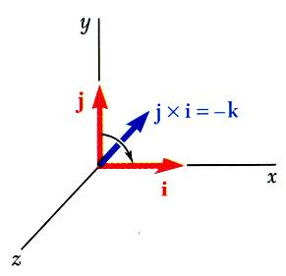


Vector Products
Vector products of Cartesian unit vectors,
Fig. 2.15

Slide 25



Rectangular Components of Moment of a Force
The moment of F about O,
Fig. 2.25

Slide 26

Varignon’s Theorem
The moment about a given point O of the resultant of several concurrent forces is equal to the sum of the moments of the various forces about the same point O.
Varigon’s Theorem makes it possible to replace the direct determination of the moment of a force F by the moments of two or more component forces of F.
Fig. 2.19

Slide 27



MOMENT OF A COUPLE
A couple is 2 parallel forces of equal magnitude acting in opposite directions separated by a distance (see Fig. 10a)
A couple can only cause a turning effect and has no tendency to cause translation in any direction
The moment of a couple has magnitude, M = F×d
The moment has the same magnitude irrespective of the point about which it is applied
Thus, moment of a couple is independent of location of O
The moment of a couple is equal to the sum of the moments of the component forces computed about an arbitrary point in space
Referring to Fig. 2.20b,
Fig. 2.20 a
This shows that the moment of a couple is independent of the location of O and depends only on the forces and the distance between them
Fig. 2.20b

Slide 28


Moment of a force
In the solution of certain problems, it is convenient to shift a given force parallel to itself and add a couple
The procedure is illustrated in Fig. 2.21 where the force F has been shifted through a distance d by the addition of a couple of magnitude Fd, with an axis perpendicular to the plane in which the force is shifted
Fig. 2.21
Resultants of various types of force systems
For coplanar nonconcurrent forces, the resultant is either a single force or a couple.
This result can be demonstrated by successive applications of the parallelogram law and the principle of transmissibility
(See Fig. 2.22) F₁ and F₂ are moved along their lines of action to their point of intersection and the parallelogram law was applied given R12
R12 was subsequently combined with F3 to obtain R123
The resultant of coplanar nonconcurrent forces will be a couple if one of the forces forms a couple with the resultant of the remaining forces
Fig. 2.22

Slide 29

Resultants of various types of force systems
The resultant of a general 3-dim force system in space is a force and a couple
If the forces are all parallel, their resultant will be either a single force or a couple in a plane parallel to the given forces
When the resultant is a single force, its position can be determined by using the Varignon theory
Example 2.9
The grid in Fig. 2.23 is composed of 1 squared meter squares. Determine the resultant of the forces if F₁ = 50 N, F₂ = 75 N, F₃ = 100 N and F₄ = 80 N.
SOLUTION
We replace each force by an equal force through the origin O, plus a couple
Vector sum of the forces at O is
Fig. 2.23

Slide 30



SOLUTION
To find the location of R,
Solving this vector equation,
The vector sum of the moments of the couples with respect to O is
The position vector r = r_{x}i + r_{y}k, locates the point of action of R

Slide 31
Example 2.11
A
A 50-N vertical force is applied to the end of a lever which is attached to a shaft at O.
Determine:
moment about O,
horizontal force at A which creates the same moment,
smallest force at A which produces the same moment,
location for a 125-N vertical force to produce the same moment,
20 cm
50 N
60º
O
Fig. 2.26

Slide 32


Example 2.11
A
Moment about O is equal to the product of the force and the perpendicular distance between the line of action of the force and O. Since the force tends to rotate the lever clockwise, the moment vector is into the plane of the paper.
20 cm
50 N
60º
O
d
M_{o}

Slide 33




Example 2.11
(b) horizontal force at A which creates the same moment
(c) smallest force at A which produces the same moment,
A
F
A
20 cm
F
20 cm
d
60º
60º
O
O
M_{o}=5.0 N.m
M_{o}=5.0 N.m

Slide 34


Example 2.11
A
(d) location for a 125-N vertical force that produce the same moment,
x
125 N
60º
O
d
M_{o}=5.0 N.m

Slide 35


Centroids and Centres of Gravity
The weight of a particle is the force of attraction which the Earth exerts on it
The weight of a rigid body is the resultant of the weights of all individual particles that constitute the body
The c.g of a body is the point through which the total weight acts for all orientations of the body
The point need not be a point inside the body, although it is very often the case.
The c.g of a body of uniform thickness can be approximately located experimentally by suspending it from a flexible cord and noting the line of action of the tension in the cord
The process is repeated with the body suspended from another point, and the c.g is then located as the intersection of the 2 lines

Slide 36



Centroids and Centres of Gravity
Fig. 2.27
The plate may be divided into a large number of small elements located at coordinates (x₁, y₁), (x₂,y₂), ………(x_{n}, y_{n})
The weights of the elements are ∆W₁, ∆W₂, ………………∆W_{n}
These weights are directed towards the centre of the Earth, but, for practical purposes, they are assumed to be parallel
These parallel force system (see Fig. 2.27) has resultant W $=∑$∆W which acts through the centre of gravity, G with coordinates (x_{G}, y_{G})
Taking moments about the y-axis

Slide 37




Centroids and Centres of Gravity
Similarly, taking moments about x,
If the number of elements is now increased infinitely, with each element becoming smaller in size, the weight ∆W becomes dW and the summation sign becomes an integral evaluated over the whole body. Hence,
It can be shown that the coordinates of the c.g of a 3-dimensional body are defined by

Slide 38


Centroids and Centres of Gravity
The centroid of a volume of space, area or line is the point which defines its geometrical centre
For a 3-dimensional body, the coordinates of the centroid of the volume of space occupied by the body are
Similar expressions may be written for the centroids of areas and lines
For a uniform or homogeneous body, the density ρ is constant throughout the body
If in equ. (1) the differential weight is expressed in terms of the density and volume, i.e. dW = ρdV, we have
similar expressions for y_{G} and z_{G} which are identical to equation (3).
Thus, for a homogeneous body, the c.g coincides with the centroid

Slide 39


Centroids and Centres of Gravity
In the study of dynamics it is often necessary to locate the centre of mass of a system of particles. The coordinates of the centre of mass are defined by
Or, in vector form,
If the acceleration of gravity, g, is the same for all particles, then
W_{i} = m_{i}g and if the numerators and denominators of these equations are multiplied by g we obtain expressions identical to those for the c.g
Hence, the location of the centre of gravity coincides with that of the c.m
NB: the concept of c.g has meaning only when a body is under the influence of gravity whereas the centre of mass is independent of gravity

Slide 40

Centroids of Common Shapes of Areas

Slide 41




Composite Plates and Areas
Composite plates
Composite area

Slide 42
Thank You
For any concerns, please contact
elearning@knust.edu.gh
elearningknust@gmail.com
0322 191132

